Slide 1


Synopsis Presentation on CampusBytes: Smart Token Canteen System
Guided By: Presented By:
Prof. Pawan Kumar Gupta Anshika Bukhariya (0827CD221012)
Apoorv Betawadkar (0827CD221015) Jay Chouksey (0827CD221038)
Abhishek Mehto (0827CD233D01)

Slide 2
Contents
Introduction
1.1 Overview
1.2 Purpose
Literature Review
Problem Statement
Proposed Solution
Objectives
Theoretical Analysis
6.1 Block Diagram
6.2 Hardware Requirements
6.3 Software Requirements
Applications
REFERENCES

Slide 3
1. Introduction 1.1 Overview
CampusBytes is a digital food ordering system made for college canteens to make the food ordering process faster and smarter. Students can easily browse the menu online through their phone or computer.They can place their order and pay online using UPI, no need for cash. After placing an order, a unique token number is generated which works as their order ID. Students can track the status of their order in real-time using the token number.Once the food is ready, students simply show the token and collect their order,avoiding long queues.The kitchen staff gets a well-organized list of orders, helping them prepare and deliver food more efficiently. It reduces confusion, avoids misplacement of orders, and saves time for both students and staff. The system includes an admin panel with useful analytics like number of orders,popular food items, and peak hours.

Slide 4
1.2 Purpose​
CampusBytes tackles key canteen challenges with tech-driven solutions:
Reduce Queues with pre-order & scheduled pickups.
Ensure Order Accuracy via clear digital menus.
Streamline Payments through cashless transactions.
Save Time by minimizing wait during breaks.
Enhance Experience with a modern, user-friendly system.

Slide 5
2. Literature Review
Sr. No. | Name of Solution/System | Features | Limitations/ Drawbacks
1 | RESTROFUN | Offers interactive dining, digital ordering, real-time tracking, personalized menus, quick service and a vibrant ambiance. | Lack of Digital Payment Integration Lack of Pre-Order Option
2 | Canteen Automation System | streamlines user management, digital ordering, cashless payments, inventory tracking, etc. | 1.Limited to Registered Users 2.Security Risks
3 | QR-based Canteen Management System | Improves efficiency and convenience | QR Code-Related Issues

Slide 6
3. Problem Statement
Traditional canteen operations often suffer from long queues, order mismanagement, and payment delays, leading to inefficiencies and customer dissatisfaction. The absence of a streamlined ordering and fulfillment system results in increased waiting times, order mix-ups, and operational bottlenecks.

Slide 7
4. Proposed Solution
Token Generation and Tracking: Each customer will receive a unique digital or printed token upon placing an order, allowing them to track the status of their order in real-time without standing in line.
Streamlined Order Management: Orders will be directly sent to the kitchen with clear details, reducing errors and ensuring faster order fulfilment. The system will allow the kitchen staff to manage and prioritize orders effectively.
Cashless Payment System: The solution will support cashless payments via UPI or mobile wallets, reducing transaction times and eliminating the need for physical cash handling.
Real-Time Order Updates: Customers can check the status of their orders on their smartphones or on digital screens within the canteen, reducing uncertainty and preventing unnecessary waiting at the counter.
Queue Management and Order Scheduling: By automating order entry and payment, the system will help eliminate physical queues at the counter, optimizing customer flow and reducing congestion during peak times.

Slide 8
5. Objectives
The system is designed to automate the food ordering process in college canteens.
It aims to reduce waiting time, avoid human errors, and improve the overall
experience for students.
Every order will generate a unique digital or printed token, which acts as a
reference number for the customer.
Customers can track their order status in real-time using the token, without
needing to stand in long queues.
It helps in reducing crowding at the counter and ensures timely service.
The solution supports cashless payments like UPI making transactions smooth and secure.
It will be built to work with the existing canteen setup, so staff can adapt
easily without major changes.
The goal is to create a fast, user-friendly, and fully digital experience for
both students and canteen staff.

Slide 9
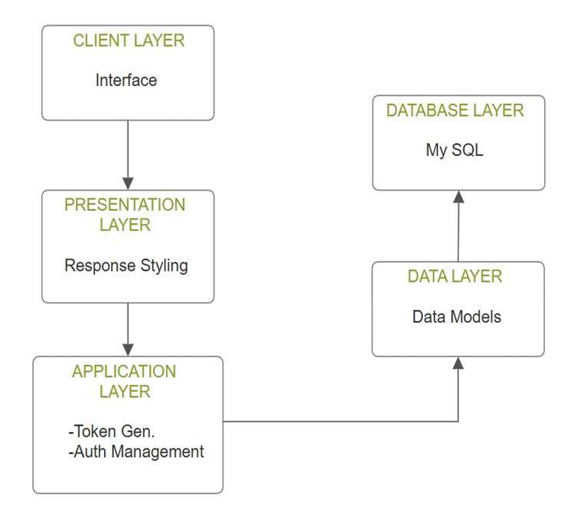
6. Theoretical Analysis
6.1 Block Diagram

Slide 10
6. Theoretical Analysis
6.2 Hardware Requirements:
Processor: Intel Xeon or AMD Ryzen (4+ cores)
RAM: 8GB
Storage: 256GB
Client (Student Access): Web browser
Kitchen Display Monitor
Network Infrastructure: High-speed campus Wi-Fi coverage
6.3 Software Requirements:
Development Environment: IDE (Eclipse, IntelliJ IDEA)
Framework: Spring Boot
Backend Technology: Java
Frontend Technologies: HTML / CSS, JavaScript
Database: MySQL

Slide 11
7.Applications
Educational Institutions(College, School Cafeterias and University Canteens)
High-volume management: Handles thousands of orders during peak lunch/dinner hours
Budget tracking: Helps students manage their monthly food expenditure
Reduced food waste: Better prediction of demand through data analytics
Corporate Environments
Quick service for limited break times: Employees can order before break periods
Visitor management: Temporary access for visitors with simplified payment options
Scheduled deliveries: Food delivered to specific meeting rooms at designated times
Healthcare Cafeterias
Staff quick-service: Essential for healthcare workers with limited breaks
Patient meal ordering: Modified interface for patient use or nurse assistance
24/7 operation capability: Supports round-the-clock healthcare operations
Staff quick-service: Essential for healthcare workers with limited breaks
Patient meal ordering: Modified interface for patient use or nurse assistance
24/7 operation capability: Supports round-the-clock healthcare operations
Pre-game ordering: Order before arriving at the venue
Timed preparation: Coordination of food readiness with event intermissions

Slide 12
GitHub Link
https://github.com/AnshikaBukhariya/CampusBytes

Slide 13
REFERENCES
Kumar, S., & Sharma, R. (2020). "Token-based ordering systems: A comprehensive review." Journal of Food Service Technology, 15(3), 112-125.
Lee, E. K., & Kim, J. (2021). "Real-time order management systems in institutional dining: Performance and challenges." IEEE Transactions on Service Computing, 12(4), 578-590.
Verma, A., Rawat, A., Chawla, A., Mishra, B., & Agarwal, A. (2022). Review of Canteen Automation System. International Journal of Advanced Research in Computer and Communication Engineering, Vol. 11, Issue 4, April 2022, DOI: 10.17148/IJARCCE.2022.11478.
Bhattarai, I. B., Bhandari, A., Pokhrel, N., Adhikari, A., & Baral, H. P. (2024). QR-based Canteen Management System. Journal of Information Technology and Digital World, 6(3), 217-227. DOI: 10.36548/jitdw.2024.3.001.
Shreya Mhalgi, Prajakta Marne, Mahesh Kulkarni, Samir Kapure, Swati Shekapure, “Cloud-based Android App for College Canteen Management System,” (IJRAR), Vol. 6, Issue 1, March 2019. Available at: http://www.ijrar.org/

Slide 14
Thank You
Queries ?

